Slide 1
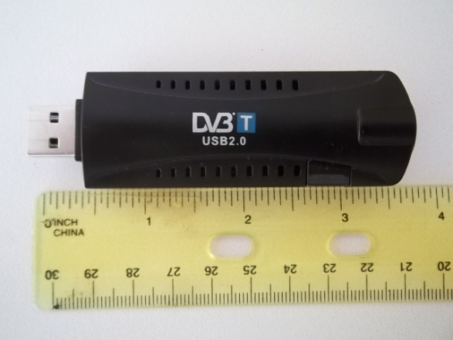
SDR Dongle Our “Eye” to the Wireless World
Mario Filippi, N2HUN, WQWL238
2016 Trenton Computer Festival
m51f08@yahoo.com

Slide 2
Wireless Communication is Not Novel
Speech
Handwriting
Sign language
Whistlers of Gomera Island (Canary Is)
Body language
Semaphore
Smoke signals
Signal drums
Mail
Pony Express
Homing pigeon
Road signs
Pheromones – animal and insect world
Bugle at reveille

Slide 3
RF Spectrum
Long wave 150 – 530 KHz
Medium wave 530 – 1710 KHz
Short wave (HF) 1.710 – 30 MHz
VHF 30 – 300 MHz
UHF 300 – 3000 MHz
SHF 3000 – 30 GHz

Slide 4
Basic Wireless Device Anatomy
Voice (AM, FM), Data (ASK, FSK, OOSK)
Receiver
Transmitter

Slide 5
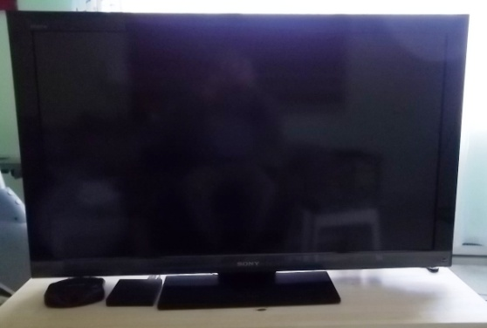
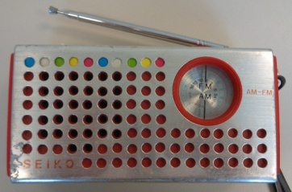
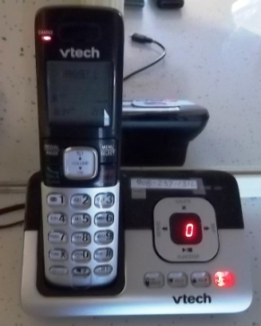
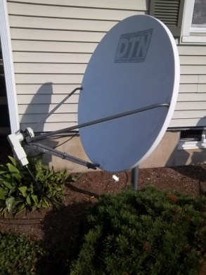
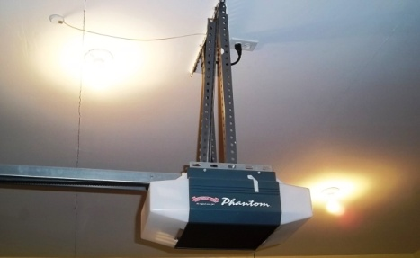
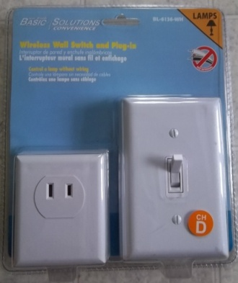
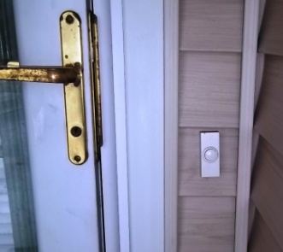
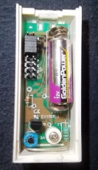
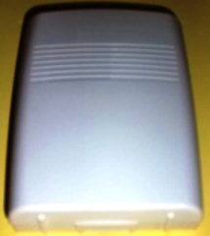
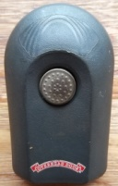
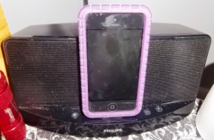
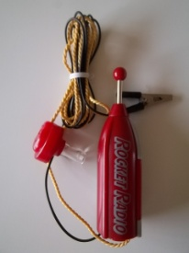
Wireless Devices - Home
540-1710 KHz
88-108 MHz
54 -216, 470-698 MHz
Satellite
C band: 3.7-4.2GHz
Ku band: 11.7-12.2 GHz
Subscription sat band: 12.2-12.7 GHz
1921-1928 MHz Tx/Rx
315 MHz Tx
390.46 MHz Rx
315.6 MHz Rx
315.6 MHz Tx
390.46 MHz Tx
315 MHz Rx
IPod

Slide 6
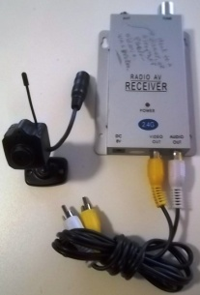
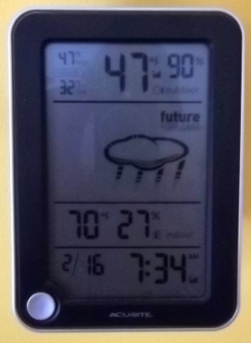
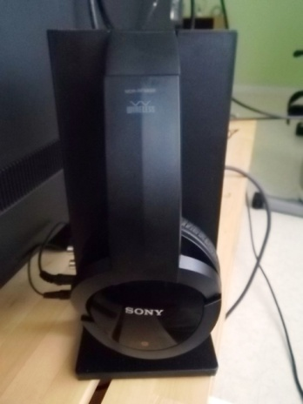
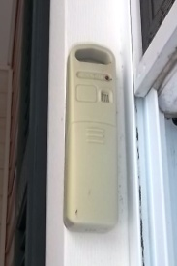
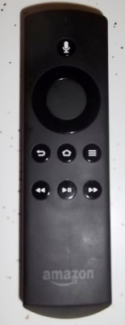
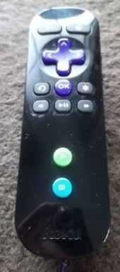
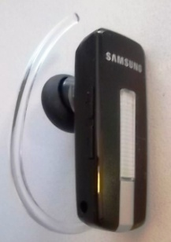
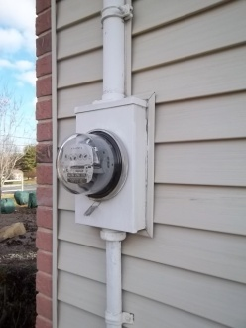
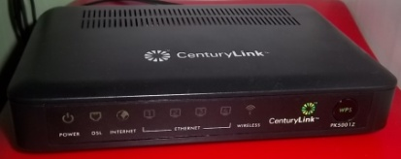
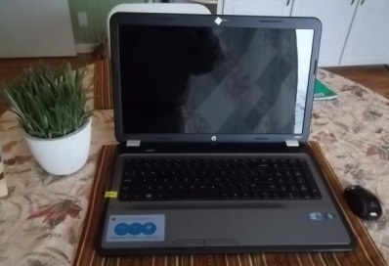
Wireless Home Devices – Home (Cont’d)
915.5 MHz Tx
915.5 MHz Rx
2.432 GHz
314.449 MHz Tx
2.412-2.462 GHz
2.480 GHz
900 MHz ISM (1W) band/2.4 GHz
2.412-2.462 GHz
2.402-2.480 GHz
824 – 849 MHz (2G)
2.4, 5 GHz

Slide 7
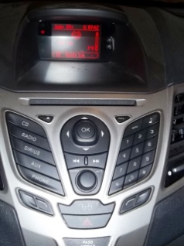
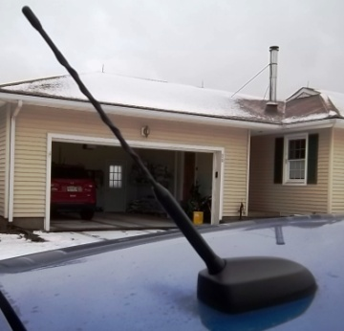
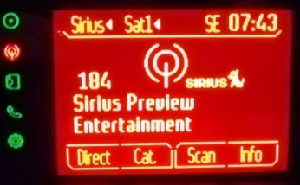
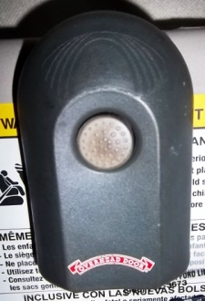
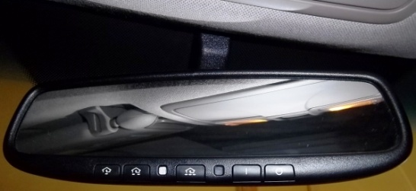
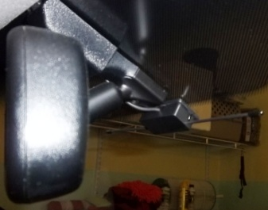
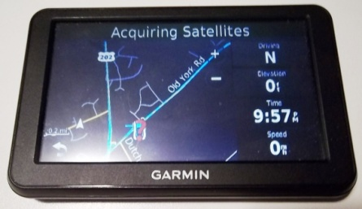
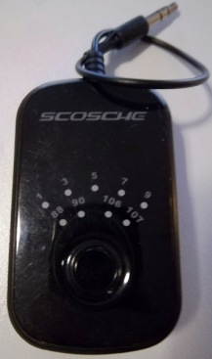
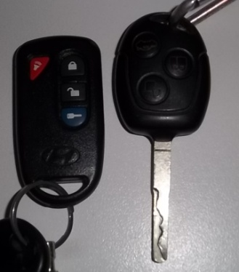
Wireless Devices – Vehicles
Ford Fiesta
Sirius/XM Satellite Radio
2.332-2.348 GHz
Console: AM/FM/Satellite
AM/FM/Satellite Antenna
“Smart” Visor for Garage Door/Indoor Light
Global Positioning System
1.227/1.575 GHz
390.46 MHz Tx
Smart Visor Dipole Antenna
315 MHz Tx
434 MHz Tx
FM Wireless Xmitter, 88-108 MHz
Wireless entry, remote starter

Slide 8
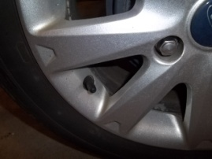
Wireless Devices – Vehicles (cont’d)
LoJack - 173.075 MHz
Rear view backup camera – 2.4 GHz
Wireless Sensing Devices: 900 MHz, 2.4 GHz band
TPMS 315, 434 MHz (ASK,FSK)

Slide 9
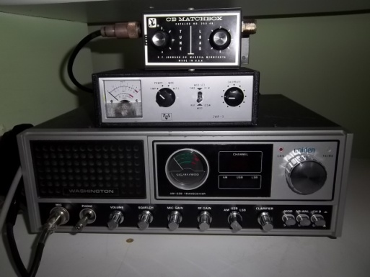
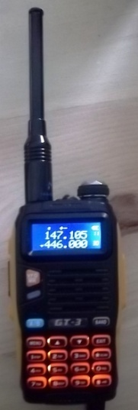
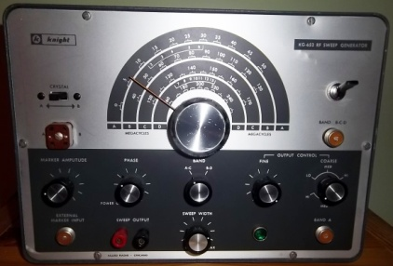
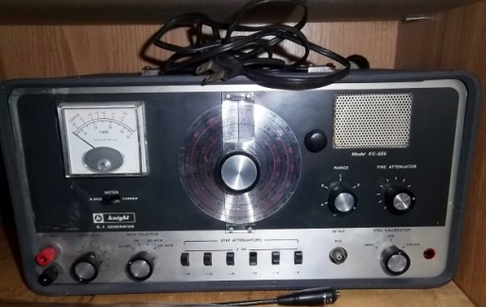
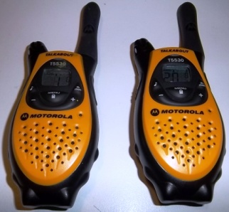
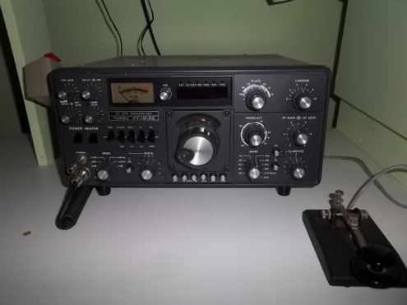
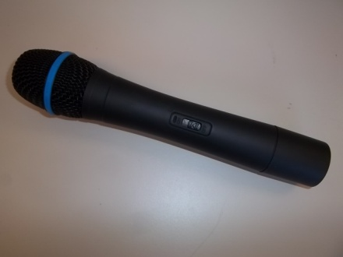
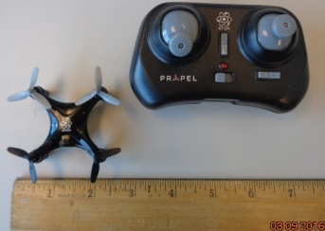
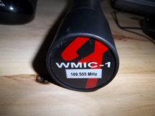
Wireless Devices – Hobbies
FM Sweep Generator 5-240 MHz
RF Signal Generator: 100 KHz – 54 MHz
2m ham: 144-148MHz
70 cm ham 440 – 450 MHz
CB: 26.965 – 27.405 MHz
FRS/GMRS: 462 & 467MHz
1.8 – 2MHz, 3.5-4 MHz, 7-7.3 MHz, 14-14.35MHz, 21-21.450 MHz, 28-29.7MHz
Micro-drone: courtesy of G. Vaccarino
Other examples:
Drones – 2.4, 5.8 GHz
R/C cars , boats– 27, 49 MHz, 2.4, 5.8 GHz
169.505MHz

Slide 10
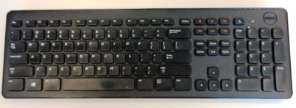
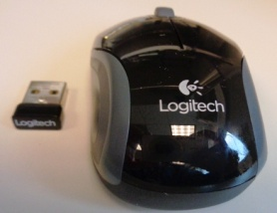
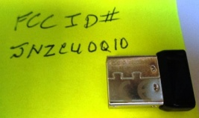
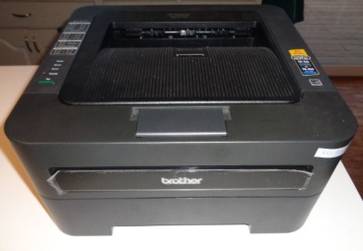
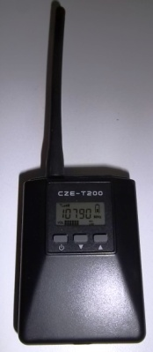
Wireless Devices – On the Job
Wireless keyboard
2.403-2.480 GHz
Wireless mouse
3G Phone
Commercial VHF handheld 144-174 MHz or 450-470 MHz
2.405-2.474 GHz
Old mice used 27 MHz band.
Wireless printer
2.412-2.462 GHz
Old printers used 27 MHz band. Some now use 5.8 GHz.
FM wireless microphone
88-108 MHz Tx

Slide 11
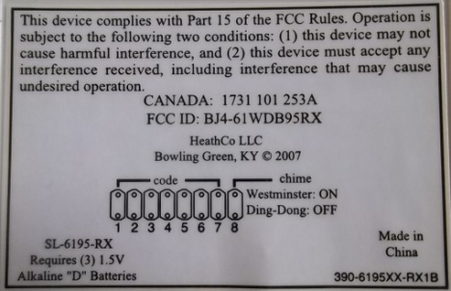
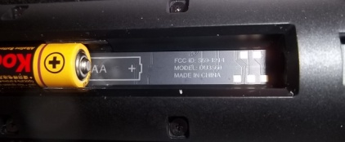
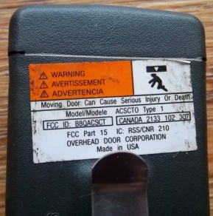
What Frequency is My Wireless Device Operating On?
Look in owner’s manual or packaging
Get FCC ID # from device
Go to www.fcc.gov and do an FCC ID search
Frequency counter (moderate $, range up to 3 GHz)
Spectrum analyzer (high $ wide spectrum range)
RTL-SDR Dongle (low $, limited to 25 – 1700 MHz)
Note: Put on your Bifocals!
MFJ-866 Frequency Ctr

Slide 12
SDR Dongle
Small broad band receiver
Originally designed to receive TV and radio broadcasts in Europe, Africa, Middle East
Plugs into USB port of computer (some Android apps available)
Needs driver + software + 5V + antenna to operate
Not a Plug ‘n Play operation
Covers frequency range 24 – 1700 MHz (Other chipsets, e.g. Elonics tuner 64 – 2300 MHz)
Low cost – well within a hobbyist’s budget
Available on-line (Nooelec, Amazon, EBay)
Modes: AM, FM, SSB, CW, some have DRM
Up to 2 MHz spectrum display
Waterfall image
Uses Zadig driver
Can use SDR#, HDSDR or other software packages such as Touchstone Pro or RTLPanorama
Useful for looking at waveforms of wireless devices, troubleshooting radio equipment, aligning/restoring radios, looking for bugs, tuning/turning antennas, checking preamp performance

Slide 13
Setting Up a Dongle to View Waveforms
Antenna
USB pigtail
SDR “dongle”
Antenna coax
2 MHz scan of FM broadcast band using SDR#

Slide 14
Wireless Device Waveforms - Home
Data burst when button is pressed
Doorbell
Data burst when switching On/Off
On/Off Switch
AM Band scan 530 – 1710 KHz
AM/FM Radio

Slide 15
Wireless Device Waveforms – Home (cont’d)
FM Band scan 88 – 108 MHz
AM/FM Radio
HDSDR Software
Touchstone Pro Software
OTA TV
Three different TV channels
Data bursts when button is pressed to open/shut door
Garage door remote
SDR# Software

Slide 16
Wireless Device Waveforms – Home (cont’d)
Wireless audio signal from program on TV set
Sony Wireless Headset
Courtesy of www.fcc.gov
Remote sensor
FCC ID
Wireless Wx Display
Remote sensor data burst

Slide 17
Wireless Device Waveforms - Vehicles
Lock
Unlock
Data burst
LoJack
Possibly TV Channel 7 (174-180 MHz)

Slide 18
Wireless Device Waveforms - Hobbies
Pronouncing “four” into microphone
Wireless mic
SDR# software
Hams talking on 2m
HDSDR audio spectrum analyzer s detects CTCSS (PL) tone
HDSDR Software
Harmonic Suppression on 54.37 MHz
Amateur Radio HT
President CB Radio Restoration
Checking Xmitter Accuracy – Ch 19 on 27.185
Checking 2nd Harmonic Suppression

Slide 19
Wireless Device Waveforms – Hobbies (cont’d)
Checking 63 MHz “Sweep”
Sweeping
Vintage Equipment Restoration – Knight KG-652
Rx frequency =950-1450 MHz
LNB down converts (LO=10.750GHz)
Telstar 12 Transponder
Ku band dish. Downlink 11.7-12.2 GHz
0% modulation
20% modulation
No modulation – problem with circuit
45 MHz signal, 1000Hz external modulation
45 MHz signal, 1000Hz internal modulation
Houston we have a problem!!!!!!
Vintage Equipment Check out– Knight KG-686

Slide 20
Wireless Waveform Screen Captures – Miscellaneous
Hi Def (HD) Radio - WOR, 710 KHz
RDS (Radio Data System) – WPST -FM
162.4-162.55 MHz NOAA Weather Stns.
NOAA Weather Satellite + WXtoIMG
DGPS Beacon using MultiPSK
WEFAX Station – Fldigi Software
RTTY Signal decoded via MMTTY
JLENS Radar Blimp
FLEX Pager

Slide 21
Wireless Waveform Screen Captures – Miscellaneous (cont’d)
ADS-B on 1090 MHz
Transposed Coaxial Collinear Antenna
ADS-B Scope Software
APRS – 144.390 MHz
Wideband discone
MultiPSK decoding
10m CW Beacons
2G Cell phone - Dialing
Cell phone tower (downlink)

Slide 22
Even More Wireless Waveform Screen Captures – (cont’d)
Decoding ACARS Using PDW
2m Ham Band During Jan. ‘16 Blizzard
Air Traffic Band During Jan. ‘16 Blizzard
Weird “Corkscrew” Signal
Railroad Comms – 160-161 MHz
433 MHz ISM Band Cornucopia
Antenna is very important!
900 MHz ISM Band Cornucopia

Slide 23
Sources for SDR
The Spectrum Monitor Magazine www.thespectrummonitor.com
Monitoring Times back issues www.monitoringtimes.com
QST back issues www.arrl.org/qst
www.rtl-sdr.com
www.hamradioscience.com
www.rtlsdr4everyone.blogspot.com
www.greatscottgadgets.com (Hack RF One)
www.YouTube.com
www.Nooelec.com
www.nutsaboutnets.com
www.amazon.com
www.ebay.com
Nooelec Up-converter
Covers 1MHZ – 6 GHz!
www.thespectrummonitor.com

Slide 24
Are You a Victim of RWS (Radio Wave Sickness)?
Symptoms
Neurological: dizziness ,irritability, headaches, insomnia, memory loss, psychosis
Digestive: nausea, abdominal pain
Glandular: enlarged thyroid, painful testicles, painful ovaries,
Dermatological: hair loss, rashes, redness of the skin
Musculoskeletal: tremors, spasms, numbness,/tingling, pain in the joints and feet
Ophthalmological: poor vision, cataracts, burning in the eyes, floaters
Otological: tinnitus (ringing in the ears)

